Slide 1
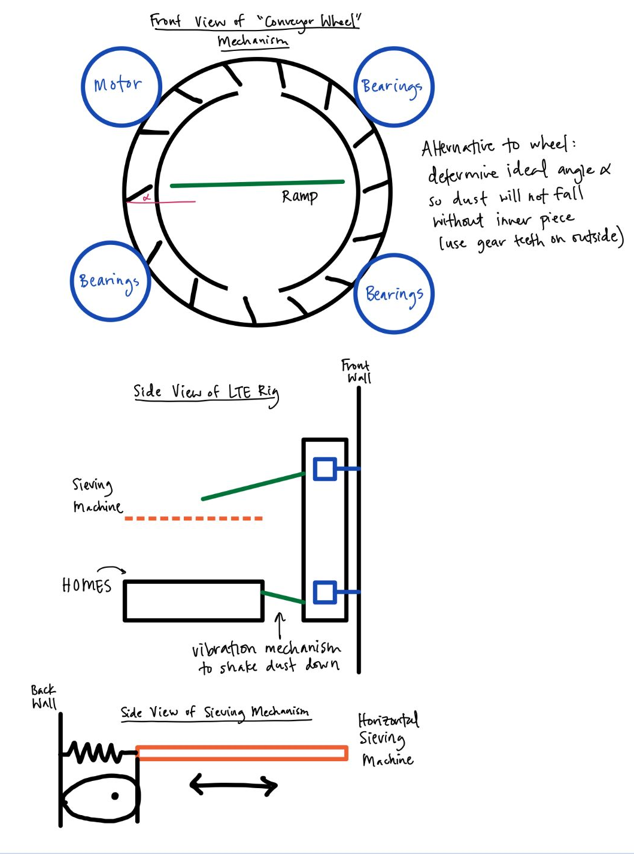
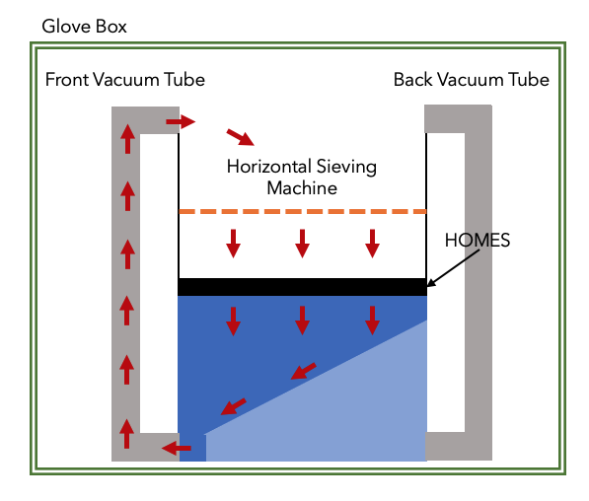




VERIFICATION
Long Term Effectiveness Rig
Kaila
4/16/21
UPDATE: Realized last week that there needs to be some extreme modifications to original LTE design
PROGRESS: Came up with design for bringing dust up
ISSUES: Still need to finalize entire design (with sieving machine) and determine parts - sets completion of rig back a few weeks
Original Plan:
New Plan:

Slide 2
Color palette RGB values
Main color palette:
Blue: R=26 G=116 B=186
Dark grey: R=58 G=58 B=60
Orange: R=255 G=108 B=12
Secondary color palette:
Light grey: R=153 G=153 B=153
Yellow: R=255 G=198 B=11

